Slide 1
Introduction to Computer Vision (CS642)
Lecture 05 - Edge Detection
Dr. Abdul Basit
Associate Professor - CS & IT University of Balochistan
June 17, 2026
Intro to Computer Vision :: Edge Detection

Slide 2





Contents
Edge detection Overview
Discontinuity in Images
Edges Characterization
3
Effect of noise over edges
4
Edge detectors
Prewit and Sobel Edge Detector Marr Hildreth Edge Detector
5
Canny Edge Detector
Non-Maximum Suppression Hysteresis Threshold
Intro to Computer Vision :: Edge Detection

Slide 3
Contents
Edge detection Overview
Discontinuity in Images
Edges Characterization
3
Effect of noise over edges
4
Edge detectors
Prewit and Sobel Edge Detector Marr Hildreth Edge Detector
5
Canny Edge Detector
Non-Maximum Suppression Hysteresis Threshold
Intro to Computer Vision :: Edge Detection

Slide 4
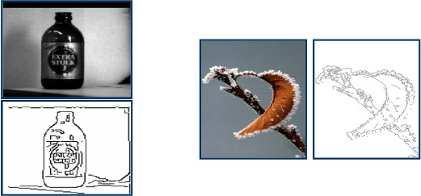
Edge detection
Overview
Figure: Edge detection examples. Reprinted from Alper Yilmez,Mubarak Shah Fall 2012UCF.
Intro to Computer Vision :: Edge Detection

Slide 5
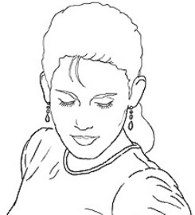
Edge detection
Overview
Edges are the sudden changes or discontinuities in an image Intuitively, most semantic and shape information from the image can be encoded in the edges
More compact than pixels
Figure: Edges in image. Reprinted from D. Lowe.
Intro to Computer Vision :: Edge Detection

Slide 6
Edge detection
Overview
Edges are used to extract information to recognize the objects. Recover geometry and view points.
Intro to Computer Vision :: Edge Detection

Slide 7
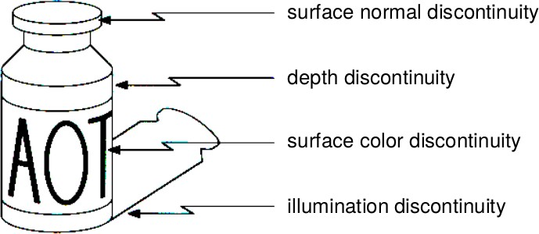
Edge detection
Overview
Edges are caused by variety of reasons.
Figure: Edges are caused by variety of factors.
Intro to Computer Vision :: Edge Detection
6 / 53

Slide 8
Contents
Edge detection Overview
Discontinuity in Images
Edges Characterization
3
Effect of noise over edges
4
Edge detectors
Prewit and Sobel Edge Detector Marr Hildreth Edge Detector
5
Canny Edge Detector
Non-Maximum Suppression Hysteresis Threshold
Intro to Computer Vision :: Edge Detection
6 / 53

Slide 9
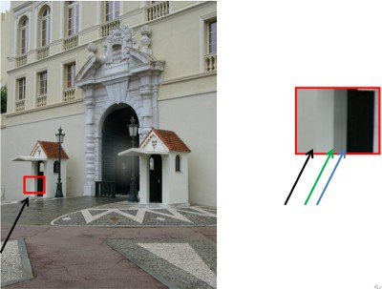
Edge detection
Discontinuities in images
The discontinuities in images cause edges.
Figure: Discontinuities in image color intensities. Reprinted from D. Hoiem.
Intro to Computer Vision :: Edge Detection

Slide 10
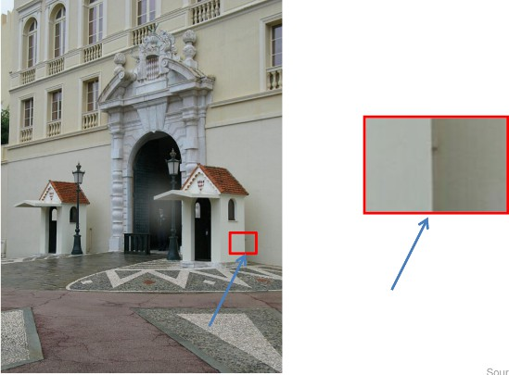
Edge detection
Discontinuities in images
The discontinuities in images cause edges.
Figure: Discontinuities in image color intensities. Reprinted from D. Hoiem.
Intro to Computer Vision :: Edge Detection

Slide 11
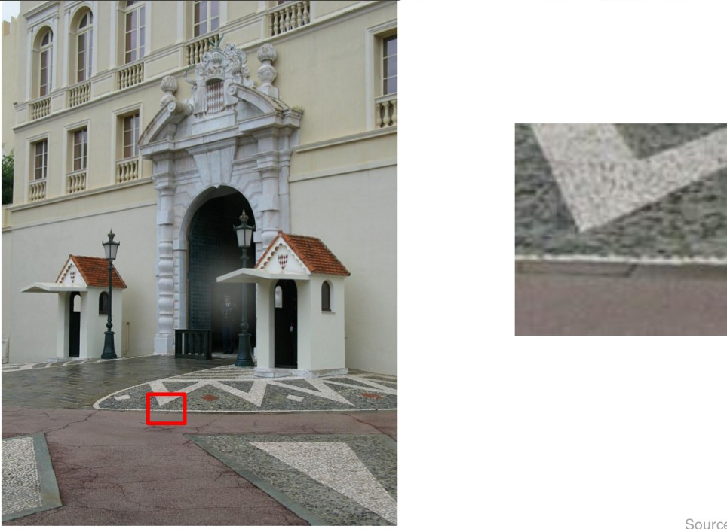
Edge detection
Discontinuities in images
Edges are caused by variety of reasons.
Figure: Discontinuities in image color intensities. Reprinted from D. Hoiem.
Intro to Computer Vision :: Edge Detection

Slide 12


Contents
Edge detection Overview
Discontinuity in Images
Edges Characterization
3
Effect of noise over edges
4
Edge detectors
Prewit and Sobel Edge Detector Marr Hildreth Edge Detector
5
Canny Edge Detector
Non-Maximum Suppression Hysteresis Threshold
Intro to Computer Vision :: Edge Detection

Slide 13
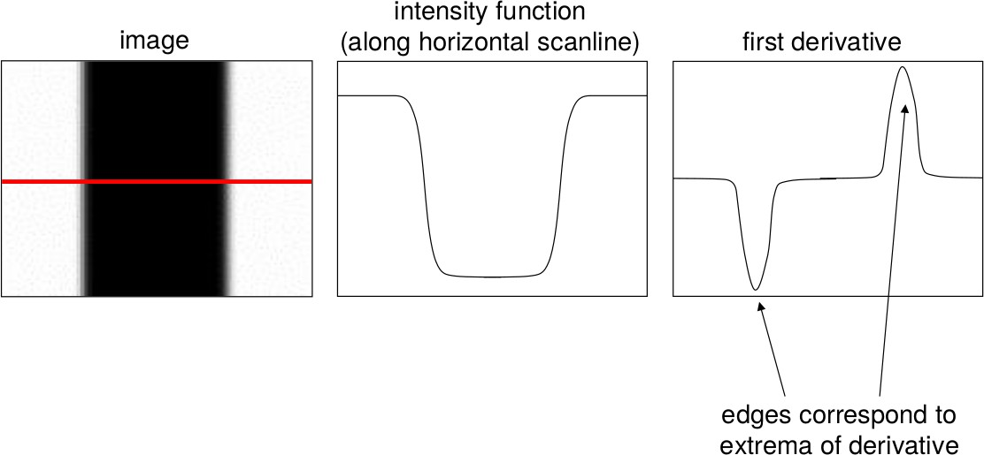
Characterizing Edges
Edges are the rapid change in the image intensity values.
Figure: Change in color intensity. Derivative shows the change.
Intro to Computer Vision :: Edge Detection

Slide 14
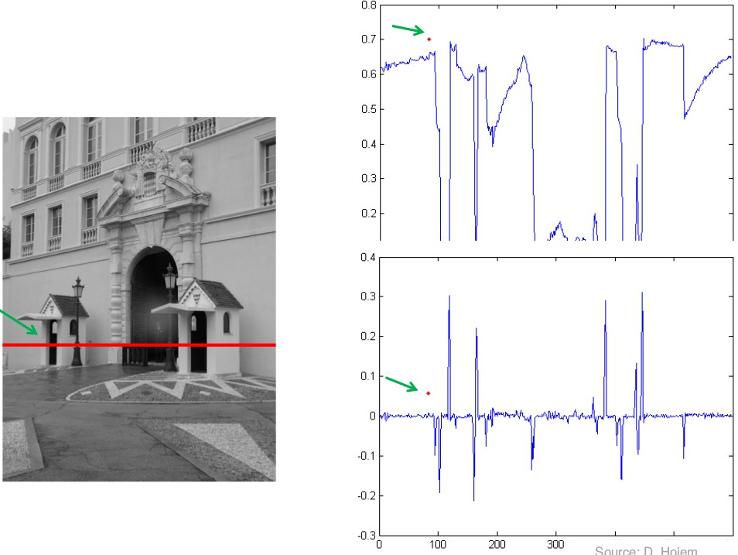
Characterizing Edges
Color Intensity and derivative (change)
Figure: Image color intensity. Source D. Hoiem.
Intro to Computer Vision :: Edge Detection

Slide 15
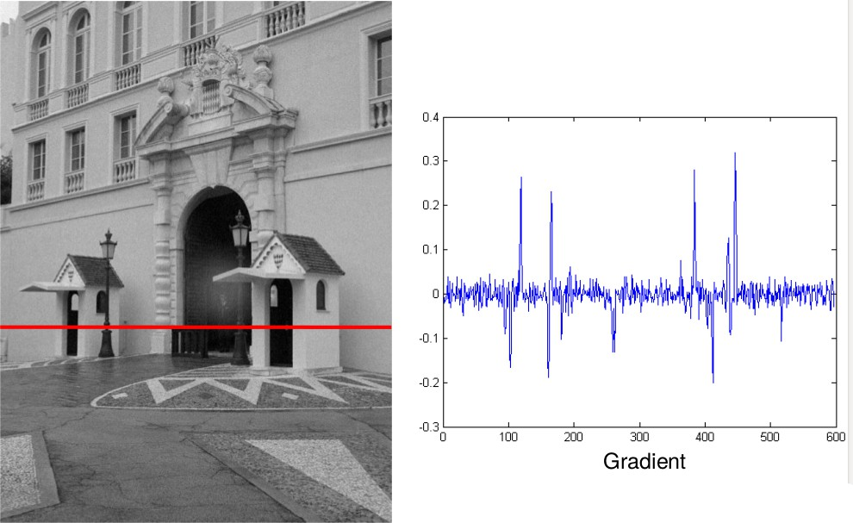
Characterizing Edges
With some Gaussian noise
Figure: Color intensity with some Gaussian noise. Source D. Hoiem.
Intro to Computer Vision :: Edge Detection

Slide 16

Contents
Edge detection Overview
Discontinuity in Images
Edges Characterization
3
Effect of noise over edges
4
Edge detectors
Prewit and Sobel Edge Detector Marr Hildreth Edge Detector
5
Canny Edge Detector
Non-Maximum Suppression Hysteresis Threshold
Intro to Computer Vision :: Edge Detection

Slide 17
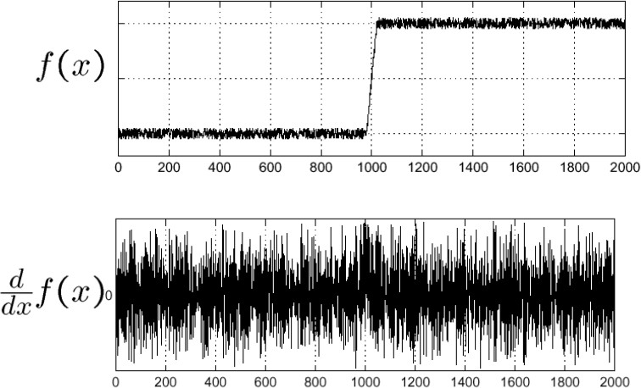
Effect of noise over edges
Plotting the image intensity.
Figure: Color intensity with some Gaussian noise. Source D. Hoiem.
Intro to Computer Vision :: Edge Detection

Slide 18
Effect of noise over edges
Difference filters respond strongly to noise
Image noise results in pixels that look very different from their neighbors
Generally, the larger the noise the stronger the response
What can we do about it?
Intro to Computer Vision :: Edge Detection

Slide 19
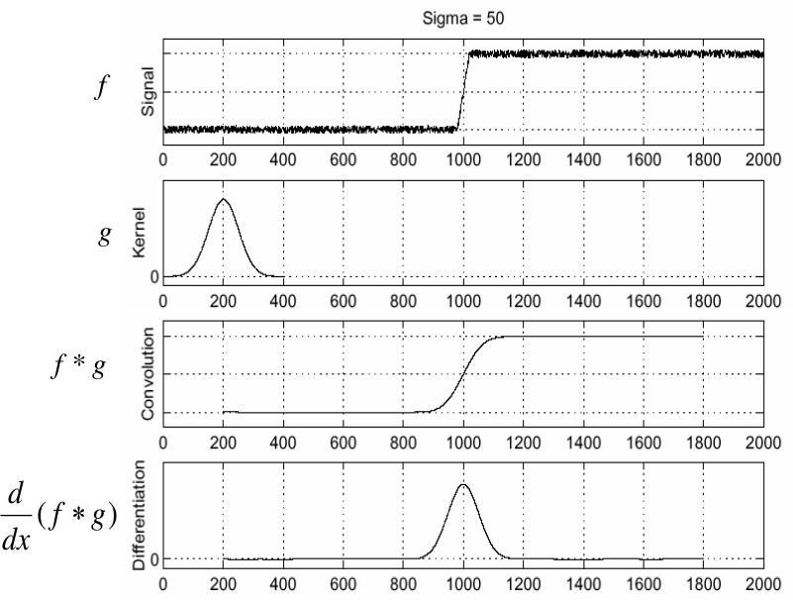
Effect of noise over edges
Smooth the image first
Smooth the image first and look for the peaks in ^{d} (f ∗ g )
dx
Figure: Source: S. Seitz.
Intro to Computer Vision :: Edge Detection

Slide 20
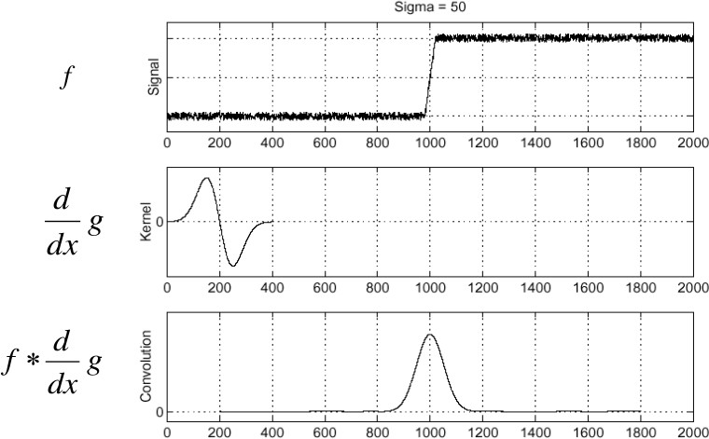
Effect of noise over edges
Derivation for the Convolution
Differentiation is convolution, and convolution is associative:
d dx
It reduces one operation.
d
(f ∗ g ) = f ∗ g
dx
Intro to Computer Vision :: Edge Detection

Slide 21
An Edge Detector
Criteria of a good edge detector.
Good detection: the optimal detector should find all real edges, ignoring noise or other artifacts
Good localization:
The edges detected must be as close as possible to the true edges The detector must return one point only for each true edge point
Intro to Computer Vision :: Edge Detection

Slide 22
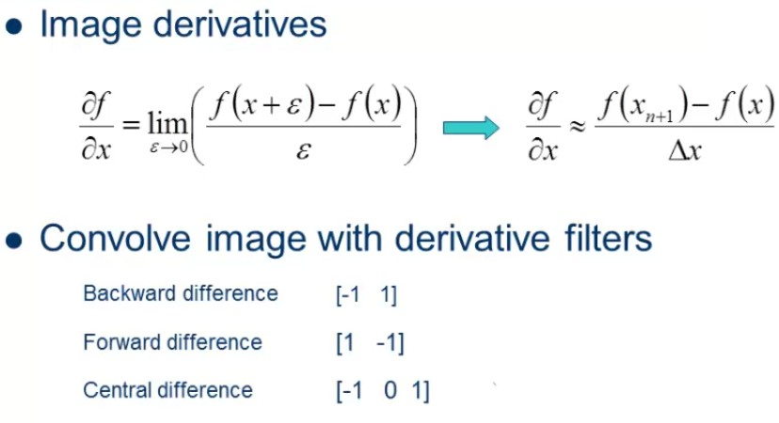
Edge detection
Detecting Discontinuities
Intro to Computer Vision :: Edge Detection

Slide 23
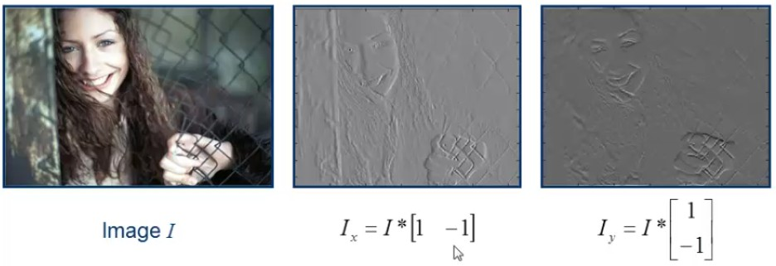
Edge detection
Image Derivatives
Figure: Source: Yilmaz, Mubarak Shah
Intro to Computer Vision :: Edge Detection

Slide 24
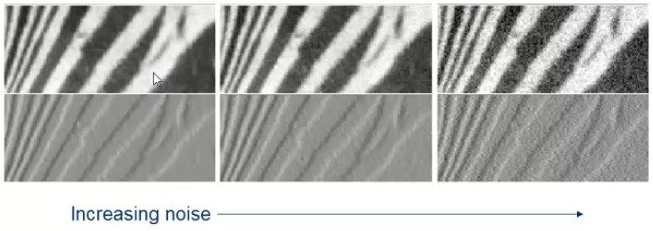
Edge detection
Derivatives and Noise
Figure: Zero mean additive Gaussian noise. Source: Yilmaz, Mubarak Shah
Intro to Computer Vision :: Edge Detection

Slide 25
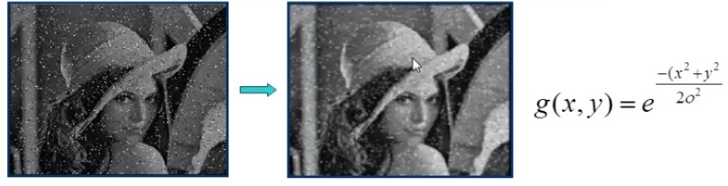
Edge detection
Gaussian Smoothing
Scale of Gaussian σ.
As σ increases, more pixels are involved in average. As σ increases, image is more blurred.
As σ increases, noise is more effectively suppressed.
Figure: Source: Yilmaz, Mubarak Shah
Intro to Computer Vision :: Edge Detection

Slide 26
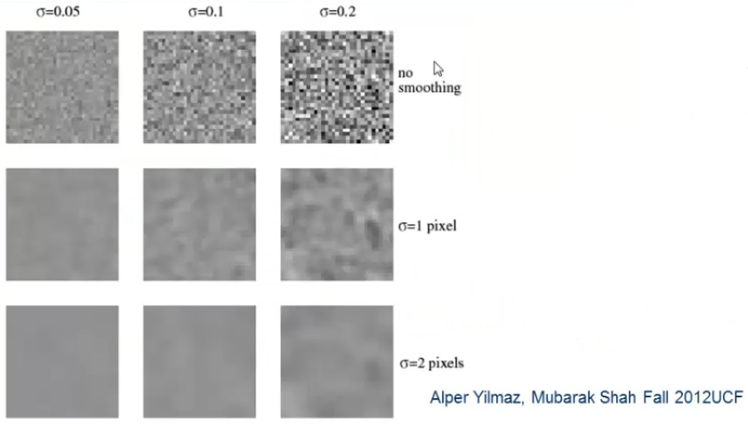
Edge detection
Gaussian Smoothing (Examples)
Intro to Computer Vision :: Edge Detection

Slide 27

Contents
Edge detection Overview
Discontinuity in Images
Edges Characterization
3
Effect of noise over edges
4
Edge detectors
Prewit and Sobel Edge Detector Marr Hildreth Edge Detector
5
Canny Edge Detector
Non-Maximum Suppression Hysteresis Threshold
Intro to Computer Vision :: Edge Detection

Slide 28
Edge detectors
Gradient operators
Prewit Sobel
Laplacian of Gaussian (Marr-Hildreth) Gradient of Gaussian (Canny)
Intro to Computer Vision :: Edge Detection
26 / 53

Slide 29
Contents
Edge detection Overview
Discontinuity in Images
Edges Characterization
3
Effect of noise over edges
4
Edge detectors
Prewit and Sobel Edge Detector Marr Hildreth Edge Detector
5
Canny Edge Detector
Non-Maximum Suppression Hysteresis Threshold
Intro to Computer Vision :: Edge Detection
26 / 53

Slide 30
Edge detectors
Prewit and Sobel Edge Detector
Compute derivatives
in x and y directions
Find gradient magnitude Threshold gradient magnitude
Intro to Computer Vision :: Edge Detection

Slide 31
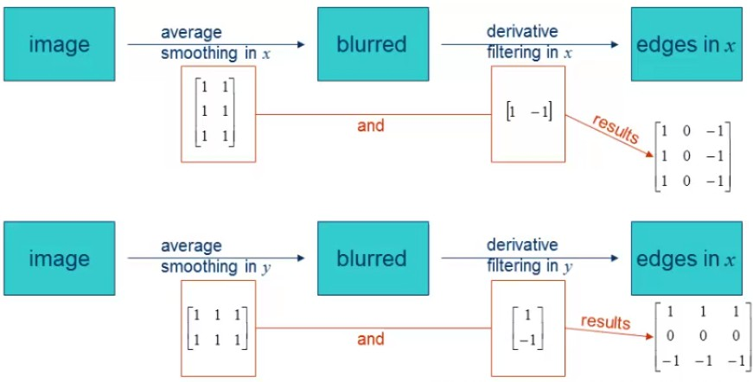
Edge detectors
Prewitt Edge Detector
Intro to Computer Vision :: Edge Detection

Slide 32
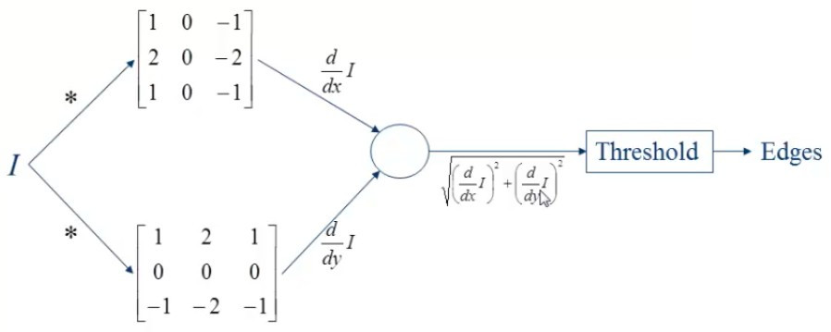
Edge detectors
Sobel Edge Detector
Intro to Computer Vision :: Edge Detection

Slide 33
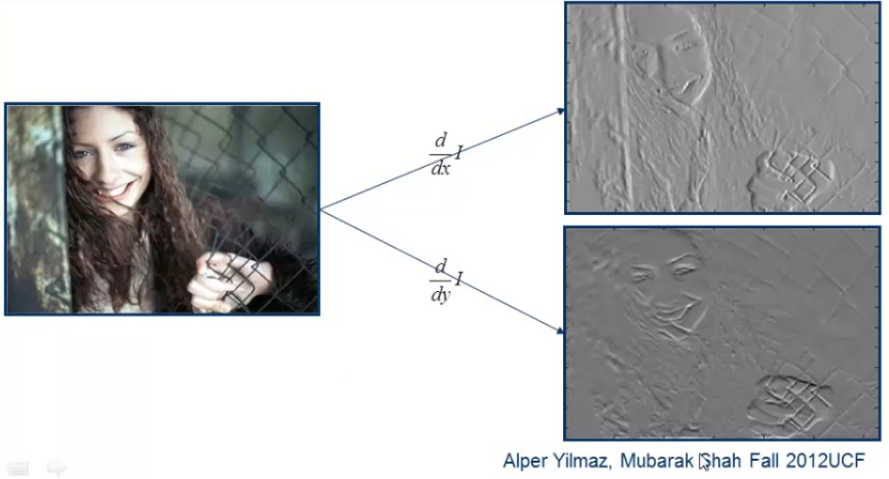
Edge detectors
Sobel Edge Detector
Intro to Computer Vision :: Edge Detection

Slide 34
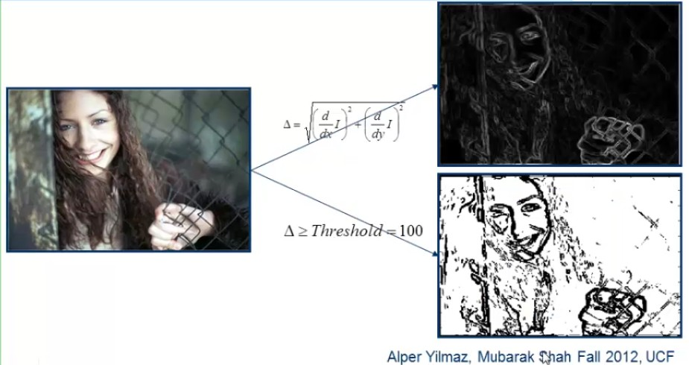
Edge detectors
Sobel Edge Detector
Intro to Computer Vision :: Edge Detection
31 / 53

Slide 35
Contents
Edge detection Overview
Discontinuity in Images
Edges Characterization
3
Effect of noise over edges
4
Edge detectors
Prewit and Sobel Edge Detector Marr Hildreth Edge Detector
5
Canny Edge Detector
Non-Maximum Suppression Hysteresis Threshold
Intro to Computer Vision :: Edge Detection
31 / 53

Slide 36
Edge detectors
Marr Hildreth edge detector
Smooth image by Gaussian filter to produce image S
Apply Laplacian to S
Used in mechanics, electromagnetics, wave theory, quantum mechanics and Laplace equation
Find zero crossings
Scan along each row, record an edge point at the location of zero-crossing.
Repeat above step along each column
Intro to Computer Vision :: Edge Detection

Slide 37
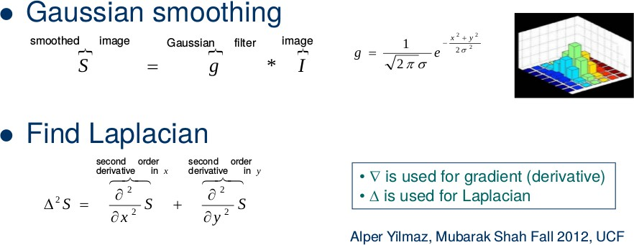
Edge detectors
Marr Hildreth edge detector
Intro to Computer Vision :: Edge Detection

Slide 38
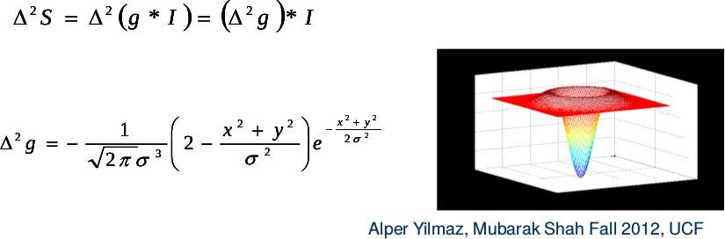
Edge detectors
Marr Hildreth edge detector
Deriving the Laplacian of Gaussian (LoG)
Intro to Computer Vision :: Edge Detection

Slide 39
Edge detectors
Finding Zero Crossing
Four cases of zero-crossings
{+,-}
{+,0,-}
{-,+}
{-,0,+}
Slope of zero-crossing {a, -b} is |a+b|. To mark an edge
Compute slope of zero-crossing Apply a threshold to slope
Intro to Computer Vision :: Edge Detection

Slide 40
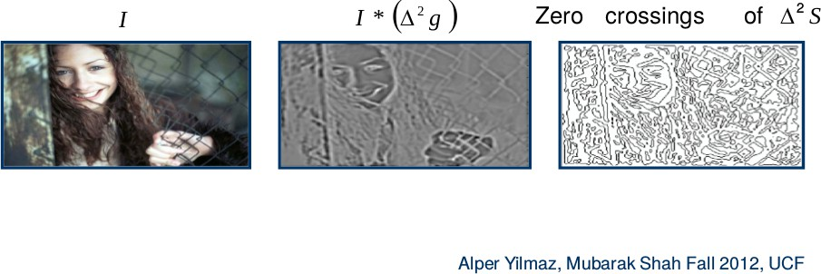
Finding Zero Crossing
Example
Intro to Computer Vision :: Edge Detection

Slide 41
Marr Hildreth edge detector
Algorithm
Compute LoG
Use 2D filter
△²g (x, y )
Use 4 1D filter
g (x ), g_{xx} (x ), g (y ), g_{yy} (y )
Find zero-crossings from each row Find slope of zero-crossings
Apply threshold to slope and mark edges
Intro to Computer Vision :: Edge Detection

Slide 42

Contents
Edge detection Overview
Discontinuity in Images
Edges Characterization
3
Effect of noise over edges
4
Edge detectors
Prewit and Sobel Edge Detector Marr Hildreth Edge Detector
5
Canny Edge Detector
Non-Maximum Suppression Hysteresis Threshold
Intro to Computer Vision :: Edge Detection

Slide 43
Canny Edge detector
Quality of an edge
Good Detection: The optimal detector must minimize the probability of false positives as well as false negatives.
Good Localization: The edges detected must be as close as possible to the true edges.
Single Response Constraint: The detector must return one point only for each edge point.
Intro to Computer Vision :: Edge Detection

Slide 44
Canny Edge detector
Algorithm steps
Smooth image with Gaussian filter Compute derivative of filtered image
Find magnitude and orientation of gradient Apply “Non-maximum Suppression”
Apply “Hysteresis Threshold”
1
2
3
4
5
Intro to Computer Vision :: Edge Detection

Slide 45
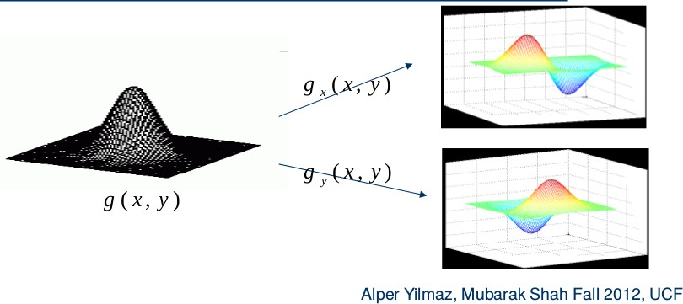
Canny Edge Detector
Derivative of Gaussian
Intro to Computer Vision :: Edge Detection

Slide 46
Canny Edge detector
Smoothing and Derivatives
1
Smoothing
S = I ∗ g (x, y ) = g (x, y ) ∗ I
2
Derivate
∇S = ∇ (g ∗ I) = (∇g ) ∗ I
g
g ∗ I
" #
∇S =
x
∗ I =
x
∂g
∂x
∂g
∂y
g_{y}
g_{y} ∗ I
g
x
∇g =
=
g_{y}
Intro to Computer Vision :: Edge Detection

Slide 47
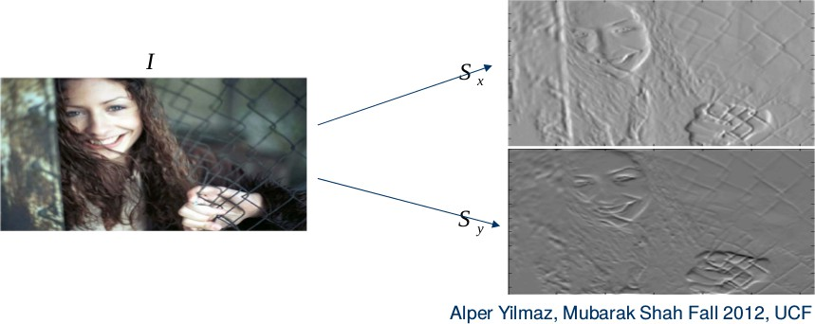
Canny Edge detector
Smoothing and Derivatives
Intro to Computer Vision :: Edge Detection

Slide 48
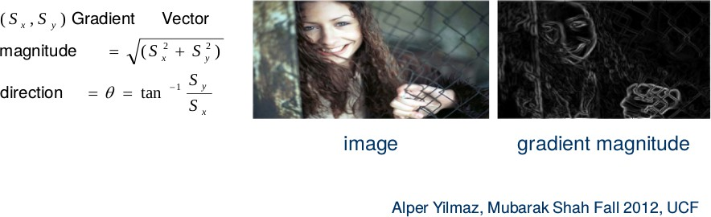
Canny Edge detector
Gradient Magnitude and Direction
Computer gradient magnitude and gradient direction
Intro to Computer Vision :: Edge Detection
44 / 53

Slide 49
Contents
Edge detection Overview
Discontinuity in Images
Edges Characterization
3
Effect of noise over edges
4
Edge detectors
Prewit and Sobel Edge Detector Marr Hildreth Edge Detector
5
Canny Edge Detector
Non-Maximum Suppression Hysteresis Threshold
Intro to Computer Vision :: Edge Detection
44 / 53

Slide 50
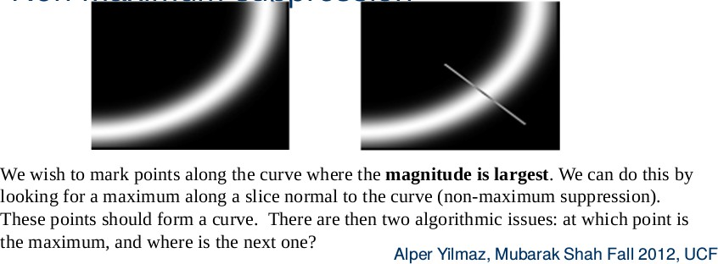
Canny Edge detector
Non Maximum Suppression
Intro to Computer Vision :: Edge Detection

Slide 51
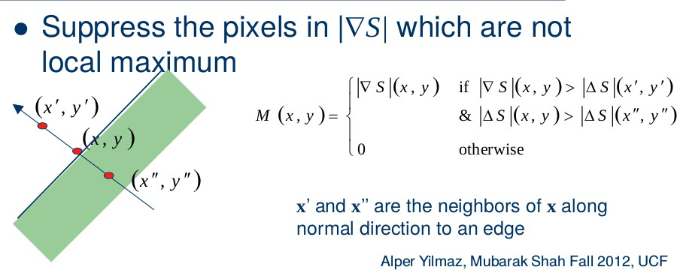
Canny Edge detector
Non Maximum Suppression
Intro to Computer Vision :: Edge Detection

Slide 52
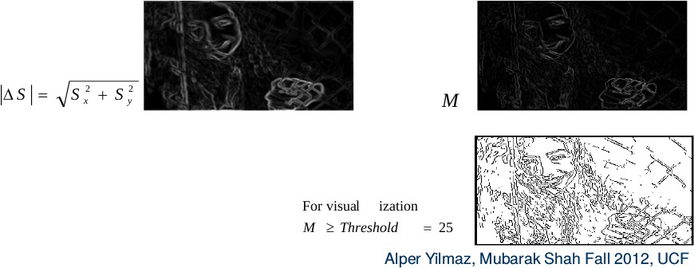
Canny Edge detector
Non Maximum Suppression
Intro to Computer Vision :: Edge Detection
47 / 53

Slide 53
Contents
Edge detection Overview
Discontinuity in Images
Edges Characterization
3
Effect of noise over edges
4
Edge detectors
Prewit and Sobel Edge Detector Marr Hildreth Edge Detector
5
Canny Edge Detector
Non-Maximum Suppression Hysteresis Threshold
Intro to Computer Vision :: Edge Detection
47 / 53

Slide 54
Canny Edge detector
Hysteresis Threshold
If the gradient at a pixel is
above High, declare it as an ‘edge pixel’ below Low, declare it as a “non-edge-pixel”
between “low” and “high”,Consider its neighbors iteratively then declare it an “edge pixel” if it is connected to an ’edge pixel’ directly or via pixels between “low” and “high”.
Intro to Computer Vision :: Edge Detection

Slide 55
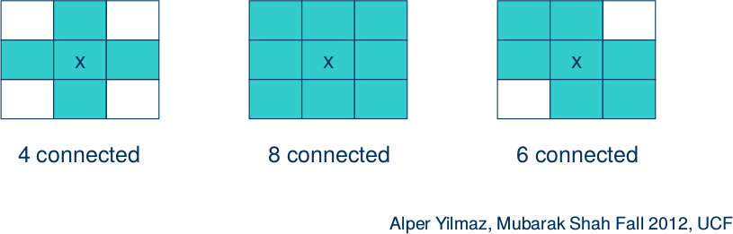
Canny Edge detector
Hysteresis Threshold
Connectedness
Intro to Computer Vision :: Edge Detection

Slide 56
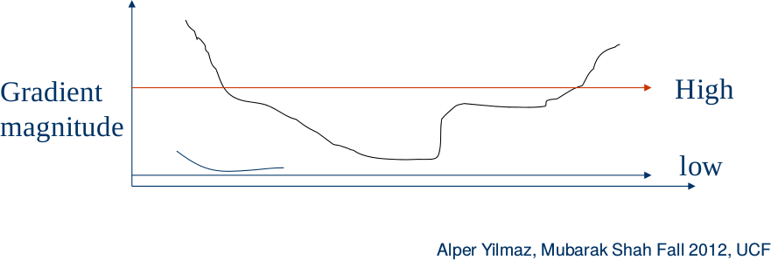
Canny Edge detector
Hysteresis Threshold
Intro to Computer Vision :: Edge Detection

Slide 57
Canny Edge detector
Hysteresis Threshold
Scan the image from left to right, top-bottom.
The gradient magnitude at a pixel is above a high threshold declare that as an edge point
Then recursively consider the neighbors of this pixel.
“If the gradient magnitude is above the low threshold declare that as an edge pixel.”
Intro to Computer Vision :: Edge Detection

Slide 58
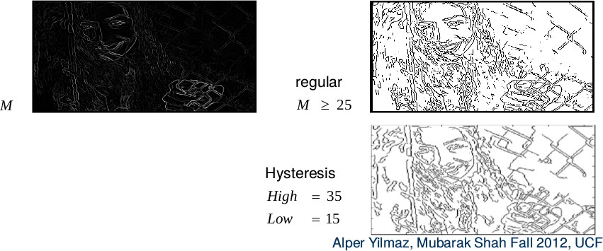
Canny Edge detector
Hysteresis Threshold
Intro to Computer Vision :: Edge Detection

Slide 59
The End
59 / 59

